Slide 1



“HEALTHY COMPETITION DRIVES THE TEAM FORWARD”

Slide 2
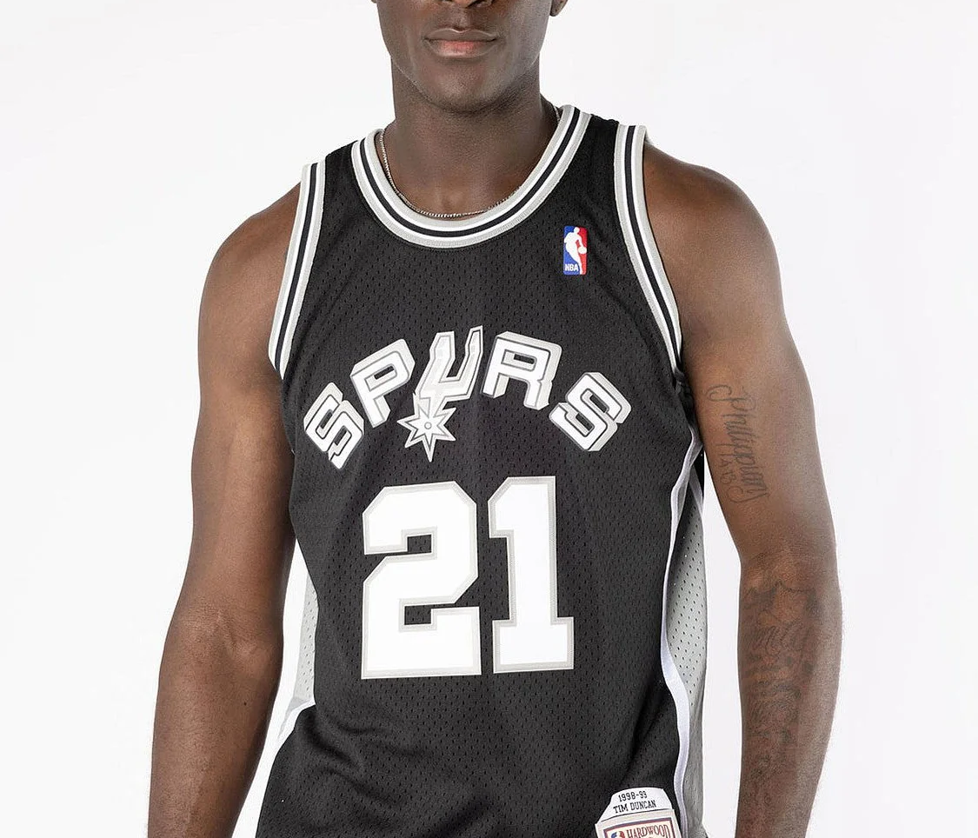


SAN ANTONIO SPURS
TRADE ANALYSIS
Start Slide

Slide 3
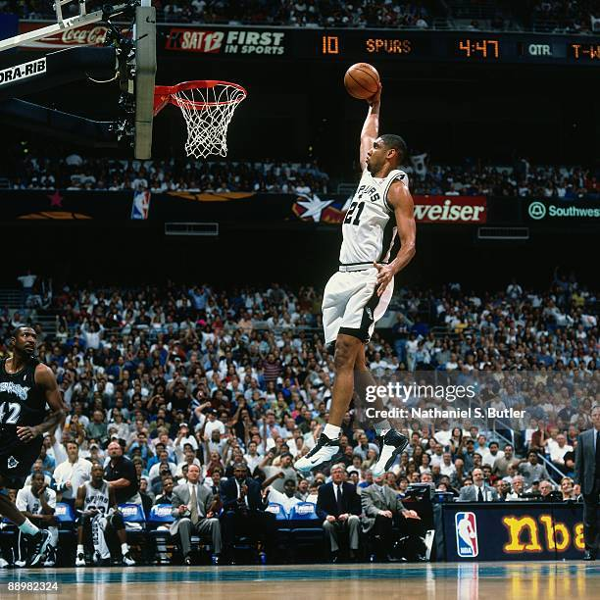




BACKGROUND
The San Antonio Spurs management plans to rebuild the roster for the 2023 season to improve team performance. This requires in-depth player statistics analysis to identify the best players by position as a basis for trading and recruitment decisions. Currently, low competition for starting spots causes core players to play consistently without much challenge, leading to reduced motivation and limited opportunities for new talent to emerge. Therefore, new players, including star players, are needed to renew competition and strengthen the team's depth.

Slide 4
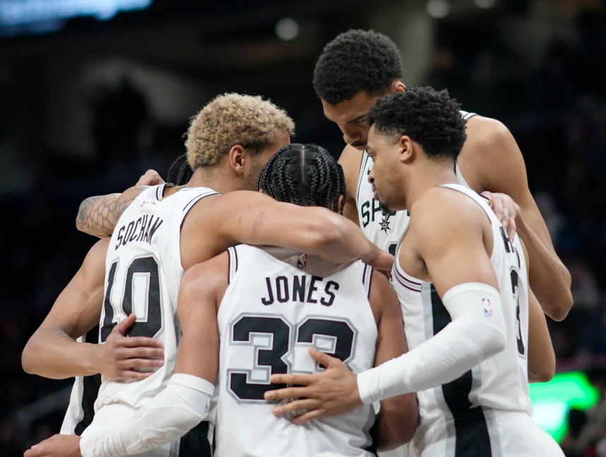


PROBLEM
STATEMENT
Perform a deep evaluation of NBA players' performance to guide decisions on trading and recruiting new players, including stars, with the aim to boost competition and strengthen team depth for the 2023 season.

Slide 5

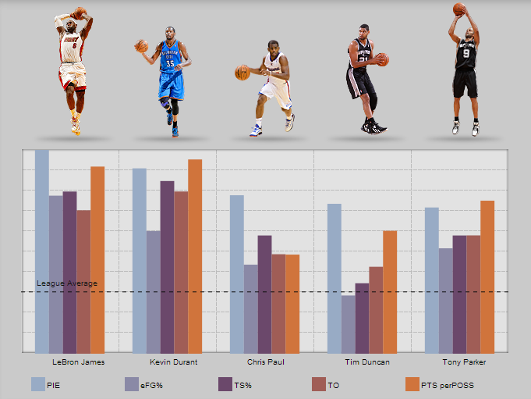

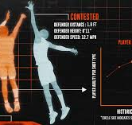
DATASET
OVERVIEW

Slide 6

DATASET OVERVIEW 1/6
This dataset is taken from kaggle. The dataset is about the performance NBA Player base on statistic. It has 14573 rows and 31 columns
Column Name | Data Type | Decription
Rk | Integer | Rank of the player
Player | String | Name of the player
Pos | String | Player Position
Age | Integer | Player Age in year

Slide 7
DATASET OVERVIEW 2/6
Column Name | Data Type | Decription
Tm | String | Team Name
G | Integer | Game played in a season
GS | Integer | Game as starter in the season
MP | Decimal | Minute played per game
FG | Decimal | Field goal made per game
FGA | Decimal | Field goal attempted per game

Slide 8
DATASET OVERVIEW 3/6
Column Name | Data Type | Decription
FG % | Decimal | Field goal percentage (FG/FGA)
3P | Decimal | Three-point field goals made per game
3P% | Decimal | Three-point field goals attempted per game
2P | Decimal | Three-point field goal percentage (3P / 3PA)
2PA | Decimal | Two-point field goals made per game
2P% | Decimal | Two-point field goals attempted per game

Slide 9
DATASET OVERVIEW 4/6
Column Name | Data Type | Decription
eFG% | Decimal | Effective field goal percentage (adjusts for 3P value)
FT | Decimal | Free throws made per game
FTA | Decimal | Free throws attempted per game
FT% | Decimal | Free throw percentage (FT / FTA)
ORB | Decimal | Offensive rebounds per game
DRB | Decimal | Defensive rebounds per game

Slide 10
DATASET OVERVIEW 5/6
Column Name | Data Type | Decription
TRB | Decimal | Total rebounds per game (ORB + DRB)
AST | Decimal | Assists per game
STL | Decimal | Steals per game
BLK | Decimal | Blocks per game
TOV | Decimal | Turnovers per game
PF | Decimal | Personal fouls per game

Slide 11
DATASET OVERVIEW 6/6
Column Name | Data Type | Decription
PTS | Decimal | Points scored per game
Year | String | NBA season year

Slide 12


ANALYSIS

Slide 13




BASKETBALL
CLUB
ACHIEVEMENT AND
Top 10 Point Guard, base on Assist, Steal and Field Goal %
Starter vs Non Starter in San Antonio Spurs
Top 10 Center, base on Point, Rebound and Block
Top 10 Rebounder in NBA
Top 10 Three Point Shooter in NBA
Presentations are tools that can be used as lectures, speeches, reports, and more. It is mostly presented like before an audience.
Presentations are tools that can be used as lectures, speeches, reports, and more. It is mostly presented like before an audience.

Slide 14
BASKETBALL
CLUB
ACHIEVEMENT AND
Player Trend Performace by Point made
Top 10 Power Forward, base on rebound, block and point
Top 10 Shooting Guard, base on 3 point, point and steal
Top Turn Over by Point Guard
Top 10 Small Forward, base on point, steal, field goal %, assist and total rebound
Presentations are tools that can be used as lectures, speeches, reports, and more. It is mostly presented like before an audience.
Presentations are tools that can be used as lectures, speeches, reports, and more. It is mostly presented like before an audience.

Slide 15


ANALYSIS RESULT

Slide 16
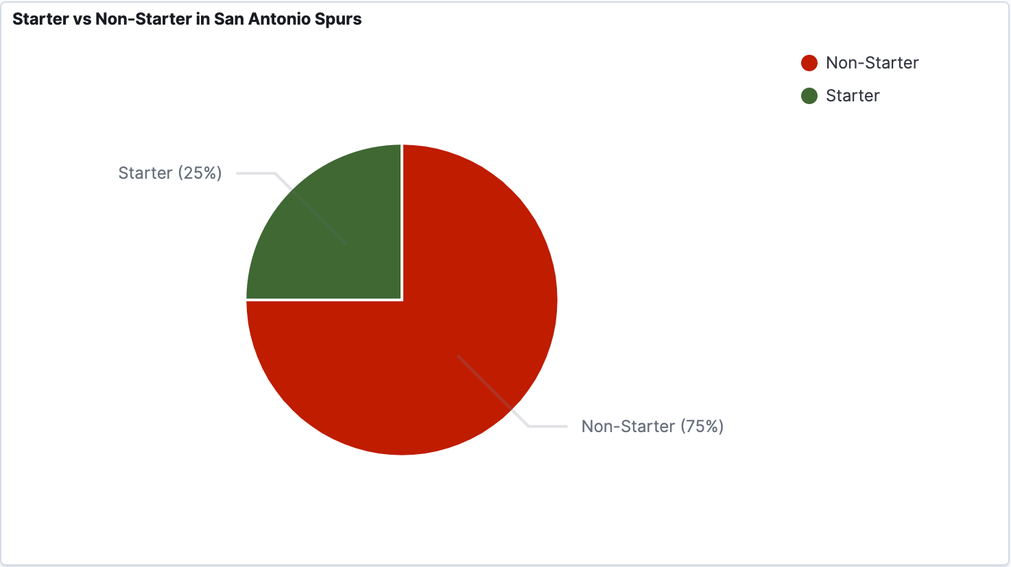
75% of players are in the Non-Starter category
Only 25 % player meet creatiria as Starter
Notes:
Using 40 games as a starter out of 82 is the standard to call a player a starter.
- About 75% of players are in the Non-Starter category, meaning they started less than 40 games during the regular season.
- Only 25% of players meet the criteria as Starters (starting 40 times or more), and these players are considered the main or regular players on their teams.
- This distribution shows that most players act as substitutes or rotation players, while only a small number are regular starters.
- Because only 25% of players often start, the competition among bench players is relatively low. This could cause the main players to have fewer strong rivals to keep them motivated and improve their performance.

Slide 17
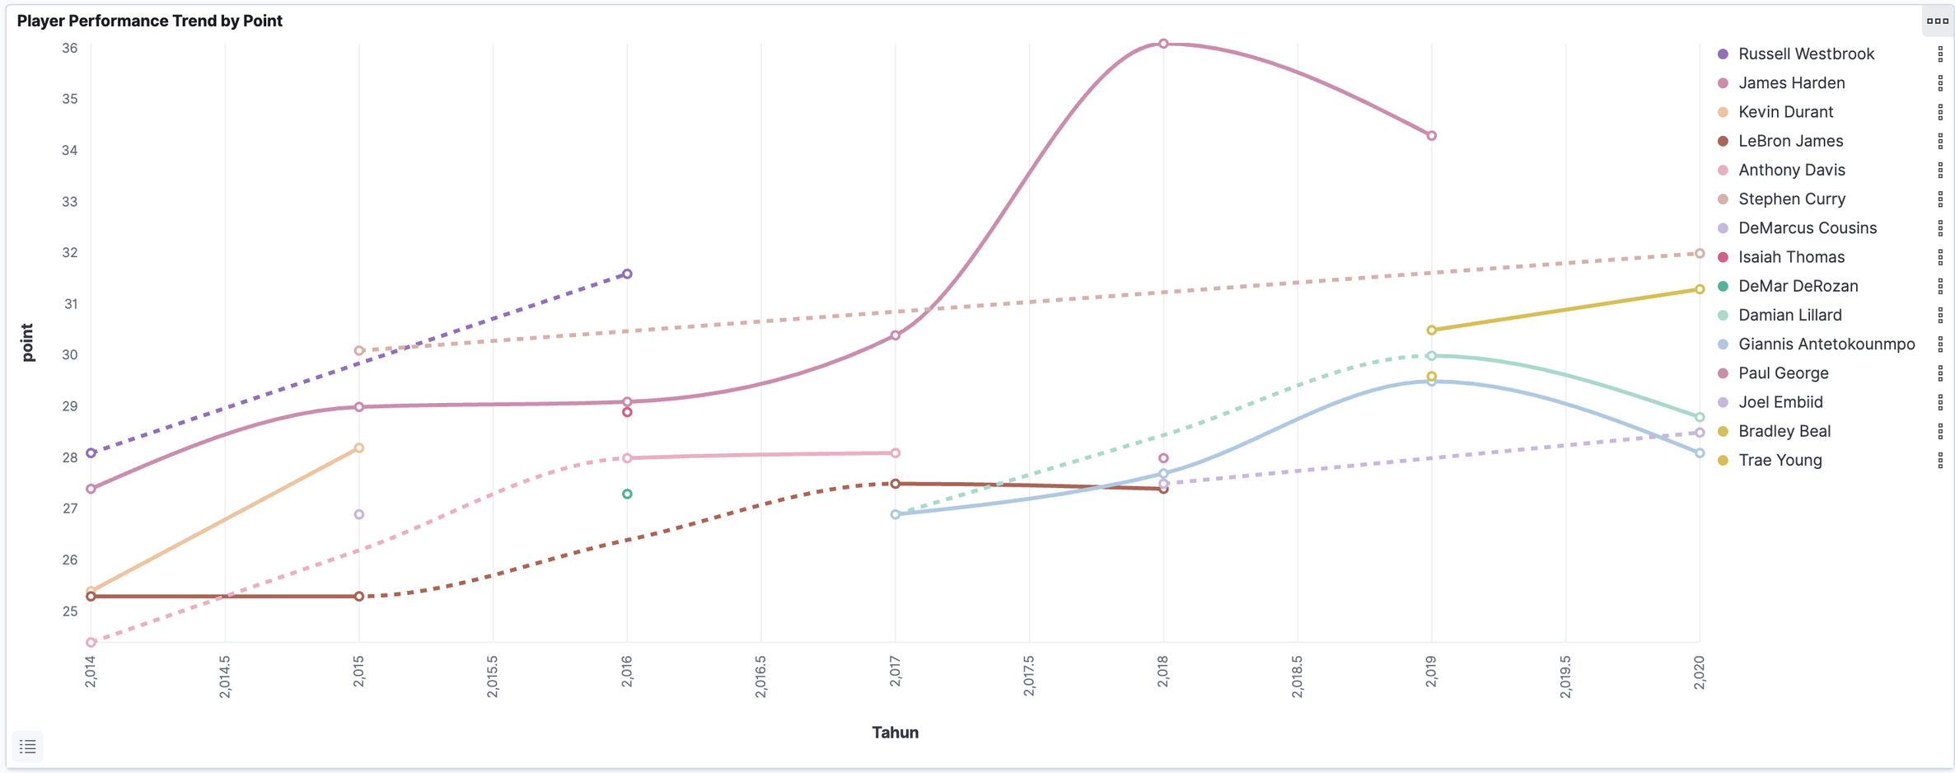
Notes:
- James Harden showed very dominant performance with a sharp increase in points scoring trend, reaching a peak around 2019-2020 with points over 36, much higher than other players.
- Players like Joel Embiid and Bradley Beal showed steady and positive improvement in their performance from year to year.
- Some players, like Damian Lillard and Giannis Antetokounmpo, had fluctuating performance but still stayed at a high competitive level (around 29-30 points).
- Players like LeBron James, Kevin Durant, and Russell Westbrook showed relatively stable performances over the period, though sometimes the data is incomplete (shown by gaps)- .
- Many players have average points in the range of 25 to 32, with James Harden as an outlier with much higher values.
- Isolated data points (without continuation) probably indicate missing data or that the player was injured during that season.

Slide 18
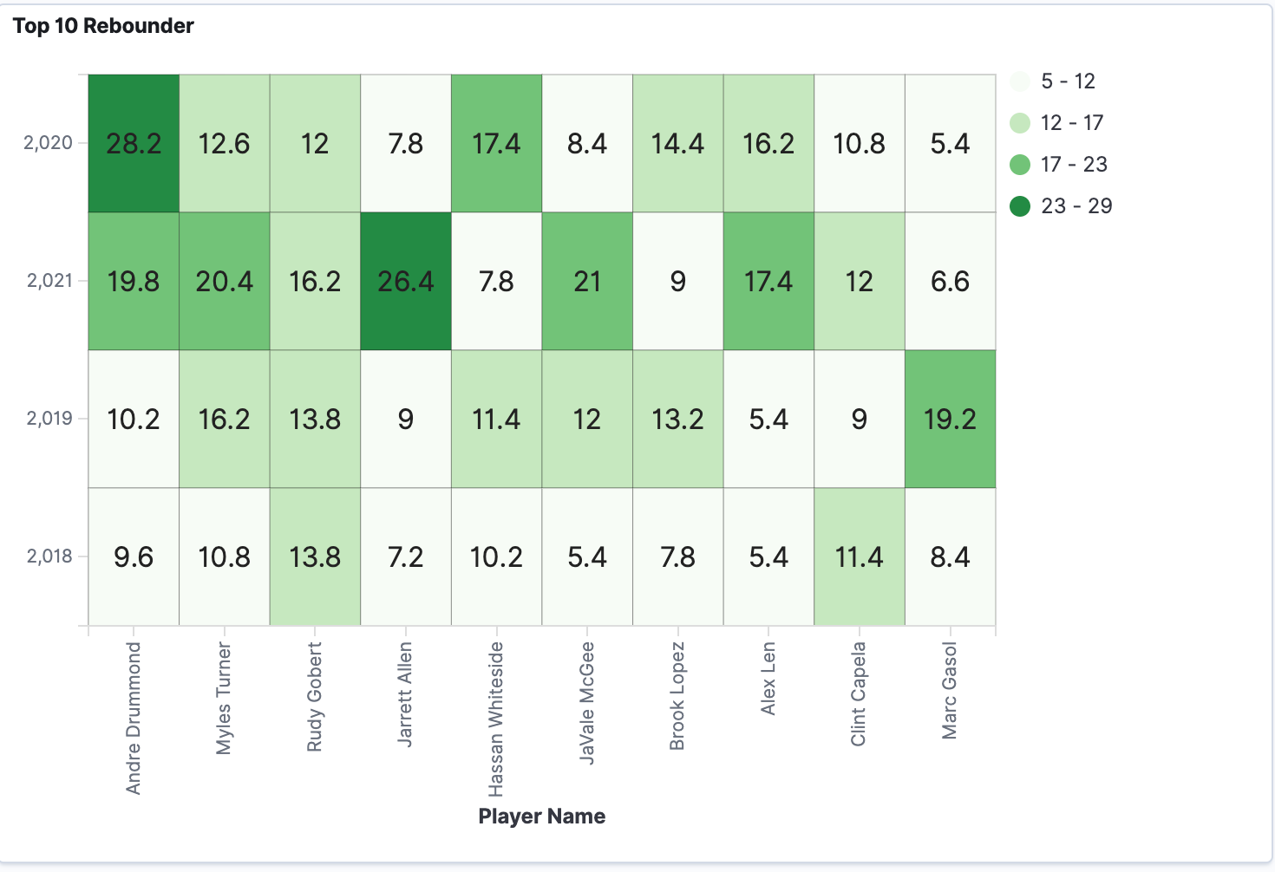
Andre Drummond is at the top as a rebounder
Jarret Allen and JaVale McGee also good at rebounding
Rudy Gobert and Myles Turner show consistent too
Notes:
Andre Drummond is at the top as a rebounder with a very high average of 28.2 rebounds in 2022, making him one of the most dominant rebounders.
Some players like Jarrett Allen and JaVale McGee show good rebounding performance but are not consistent every year.
Players like Rudy Gobert and Myles Turner show fairly consistent and stable rebounding performance each season.
There is variation in rebounding numbers from year to year, which might show changes in players' roles, playing time, or team strategy.

Slide 19
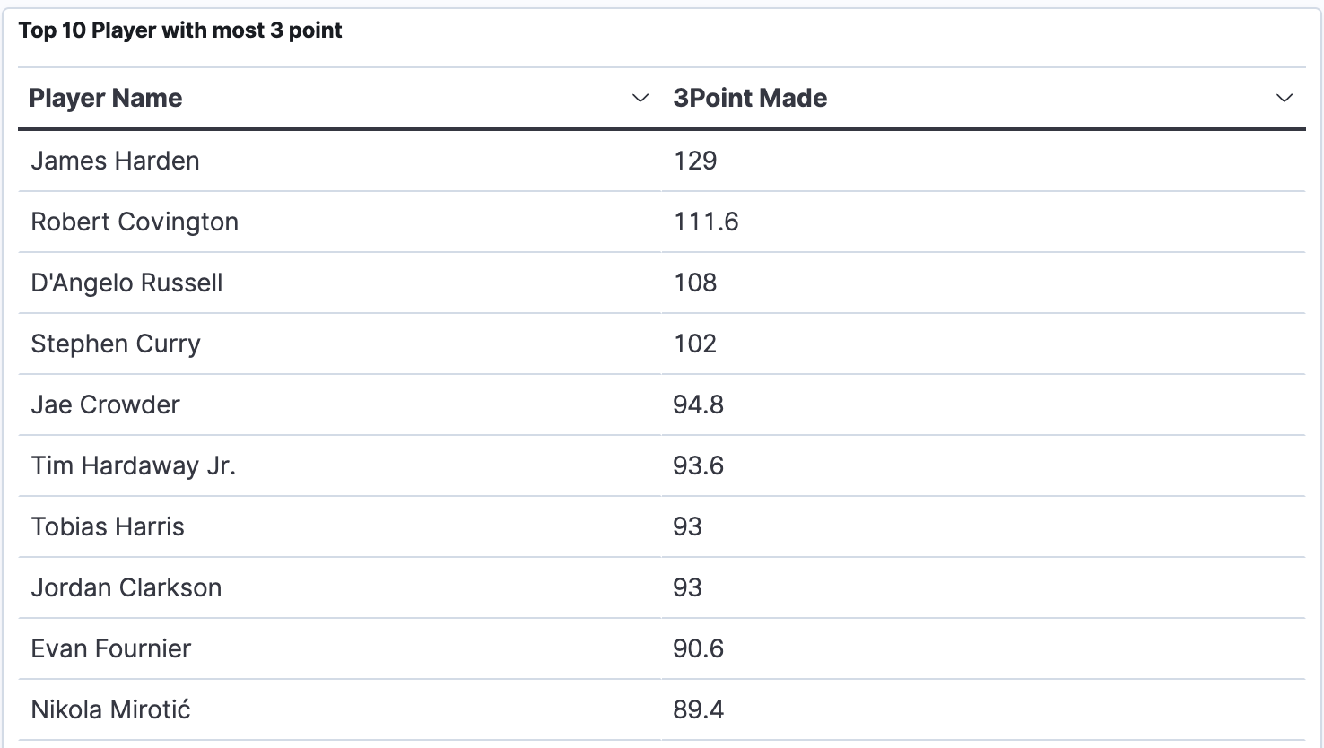
James Harden leads with 129 three-point shots made
Robert Covington and D'Angelo Russell follow him
Stephen Curry, known as one of the best shooters in the NBA
Notes:
James Harden leads with 129 three-point shots made, showing he is a very skilled and consistent long-distance shooter. This confirms his role as one of the best 3-point shooters in the league.
Robert Covington and D'Angelo Russell follow him with significant contributions, each making over 100 three-point shots. This shows that besides James Harden, there are other players who are also threats with their 3-point shooting.
Stephen Curry, known as one of the best shooters in the NBA, is in 4th place with 102 three-point shots made, strengthening his reputation as a world-class shooter.
Other players like Jae Crowder, Tim Hardaway Jr., Tobias Harris, Jordan Clarkson, and Evan Fournier also show strong 3-point shooting skills, which is important because the NBA now focuses more on attacking beyond the 3-point line.

Slide 20
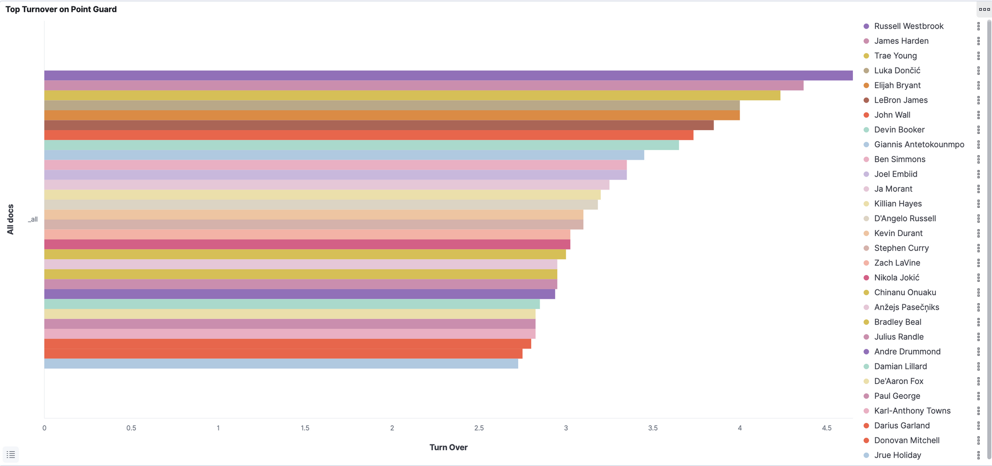
Notes:
Russell Westbrook is the point guard with the highest number of turnovers, close to 4.5 per game, showing a fairly high rate of losing the ball during his play.
James Harden and Luka Doncic are also in the top three with turnovers of about 4.3 and 4.1 per game, indicating their dominant role in ball possession but also a significant risk of turnovers.
Other well-known players like Trae Young and LeBron James also have high turnovers, around 4 per game, which can be seen as a consequence of their aggressive playing style and role as main playmakers.
In general, point guards tend to have higher turnovers compared to other positions because they handle the ball more frequently and are responsible for organizing the offense.

Slide 21
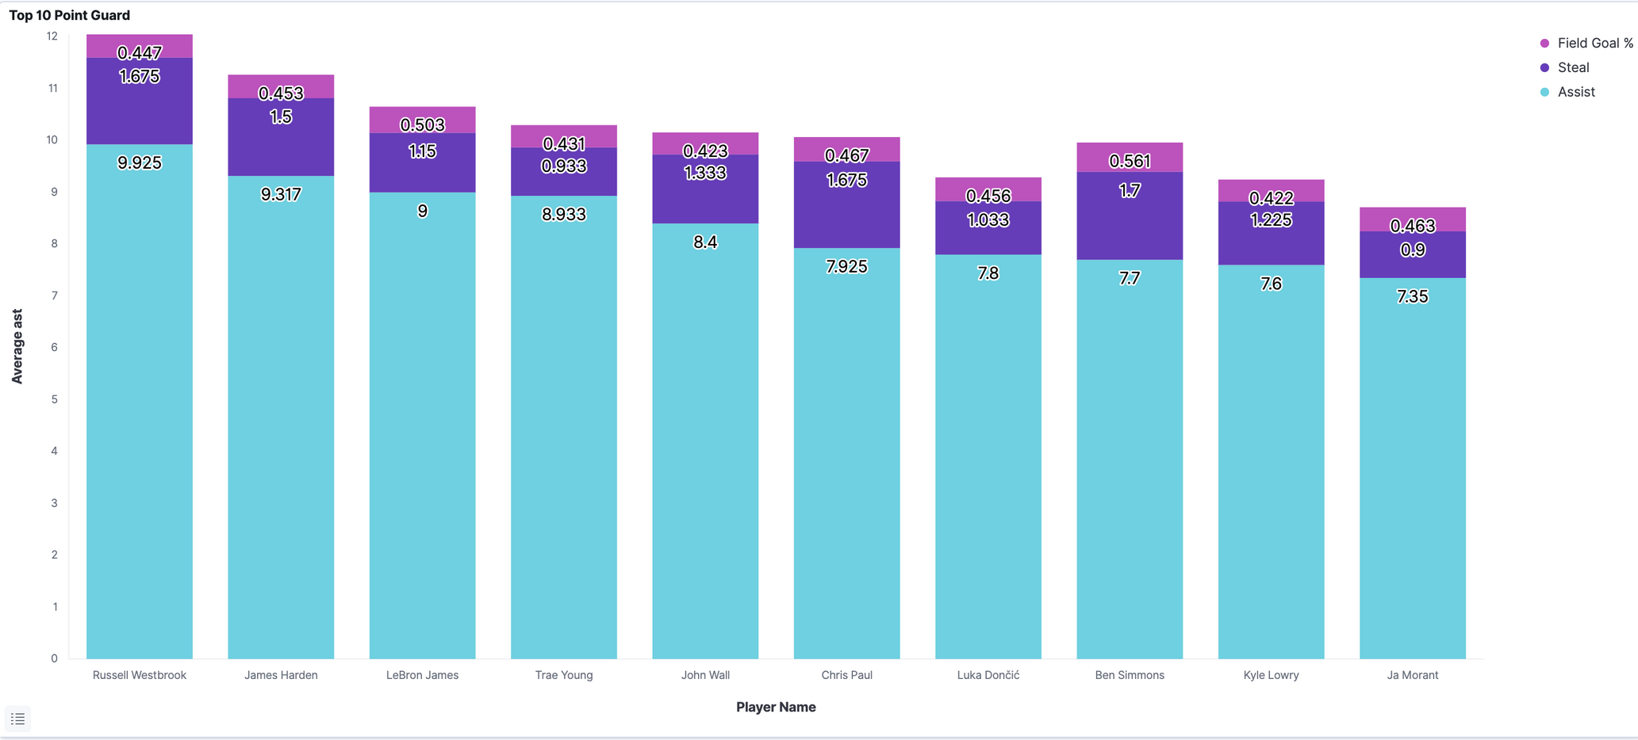
Notes:
Russell Westbrook stands out as a Point Guard with the highest average assists (about 9.93), followed by - James Harden and LeBron James. This shows Westbrook is very good at helping his teammates score.
Steal (STL) and Field Goal % (FG%) for point guards vary quite a bit. Ben Simmons has the highest FG% (56.1%), and he also has a high steal number (1.7). This means he shoots well and is good at stealing the ball.
John Wall and Chris Paul have high steal numbers (about 1.33 and 1.68), showing they help a lot on defense.
Most point guards have a Field Goal % between 42% and 47%. This means they are okay to good at making shots for their position.
Generally, there is a trade-off between assists and steals. Some players are better at helping teammates score (high assists), while others are better at defending and stealing the ball (high steals).

Slide 22
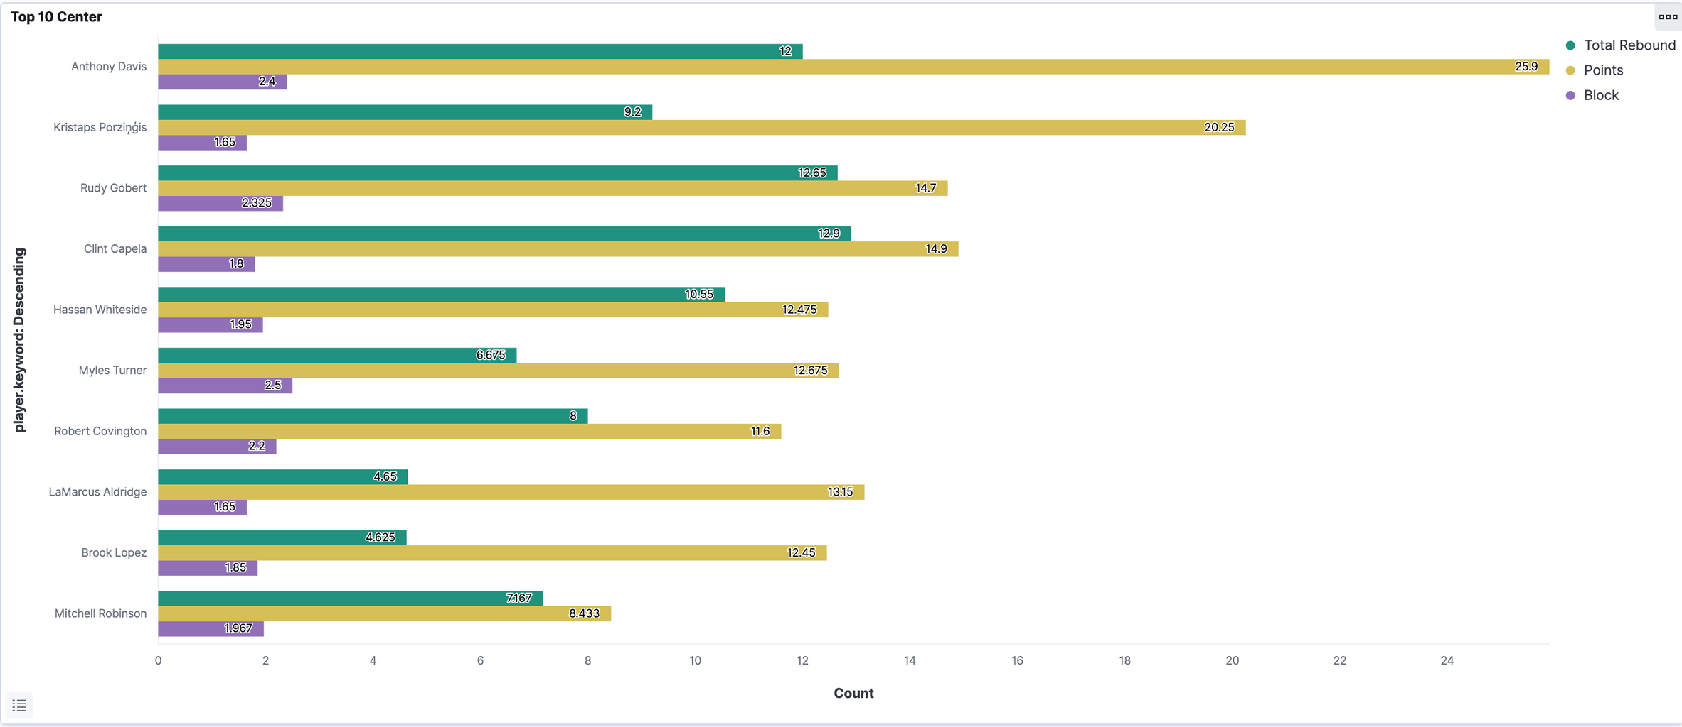
Notes:
Anthony Davis stands out as the top center with the highest total rebounds (12) and very high points (25.9), even though his blocks are relatively low (2.4). This shows he is a very productive center, scoring a lot and controlling the area near the basket.
Rudy Gobert and Clint Capela are strong in rebounds and blocks, meaning they play a big defensive role and protect the area under the basket (average blocks are 2.3 and 1.8). They are not the main scorers but very dominant in defense and rebound control.
Kristaps Porzingis and Hassan Whiteside have quite high points with medium rebounds and blocks, showing they can do many things well in the paint area.
Other players like Myles Turner, Robert Covington, LaMarcus Aldridge, and Brook Lopez show a decent mix of points and rebounds but not many blocks. This reflects a type of center or power forward who focuses more on scoring and rebounding.
Mitchell Robinson appears to be an efficient center in blocks (1.96) and rebounds (7.16) but scores fewer points (8.43), indicating his focus is on defense.

Slide 23
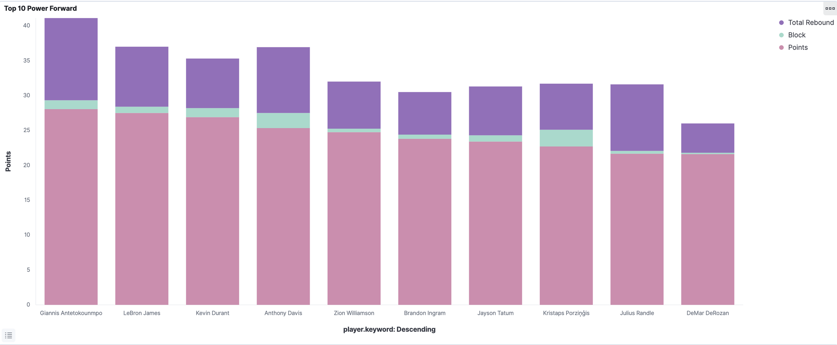
Notes:
Giannis Antetokounmpo remains the player with the highest overall total contribution, with combined points (Points + Rebound + Block) close to 42, confirming his role as the most dominant power forward.
LeBron James is in second place, with a total contribution around 37, dominating in points and total rebounds.
Anthony Davis and Kevin Durant stand out with fairly balanced total contributions around 35 to 37, showing strong performance supported by rebounds and blocks.\
Zion Williamson is in fifth place with an average total points around 32.7, showing a significant contribution although still lower than Giannis, LeBron, and Anthony Davis. His stats are dominated by points and rebounds, with relatively smaller blocks.
Other players like Brandon Ingram, Jayson Tatum, Kristaps Porzingis, Julius Randle, and DeMar DeRozan have total points ranging between 26 to 32, with points as the dominant component followed by rebounds and smaller blocks.
In general, points are the largest component of contribution among all power forwards, followed by total rebounds as an important element of defense and ball control, and blocks which, although relatively small, remain an important additional value in team defense.

Slide 24
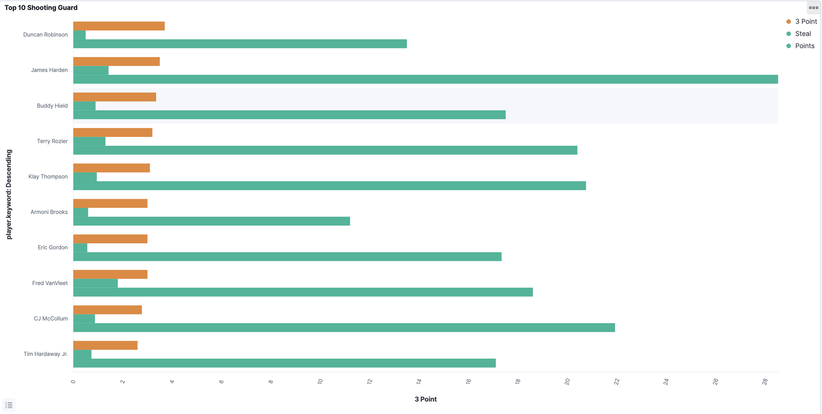
Notes:
- James Harden stands out as the Shooting Guard with the highest total points, significantly more than other players, reaching nearly 30 points. This confirms his role as the main scorer.
- After James Harden, players like CJ McCollum, Klay Thompson, and Terry Rozier also show strong scoring performance, with points ranging from about 15 to 20.
In terms of three-point shooting
- Klay Thompson and Buddy Hield are the players who attempt the most three-point shots, highlighted by a dominant orange color, indicating their strength as 3-point shooters.
Other players, such as Fred VanVleet, Tim Hardaway Jr., and Duncan Robinson, also contribute significantly to three-point shooting, even if their total points might be lower than others.
Regarding steals:
- Steals are generally less frequent compared to points and three-point shots but are still present, especially among players like Fred VanVleet and Armoni Brooks, showing their important role in defense.
- Players with high contributions in points and three-pointers are usually the main scorers of their teams, while players with notable steals tend to focus more on defensive roles.

Slide 25
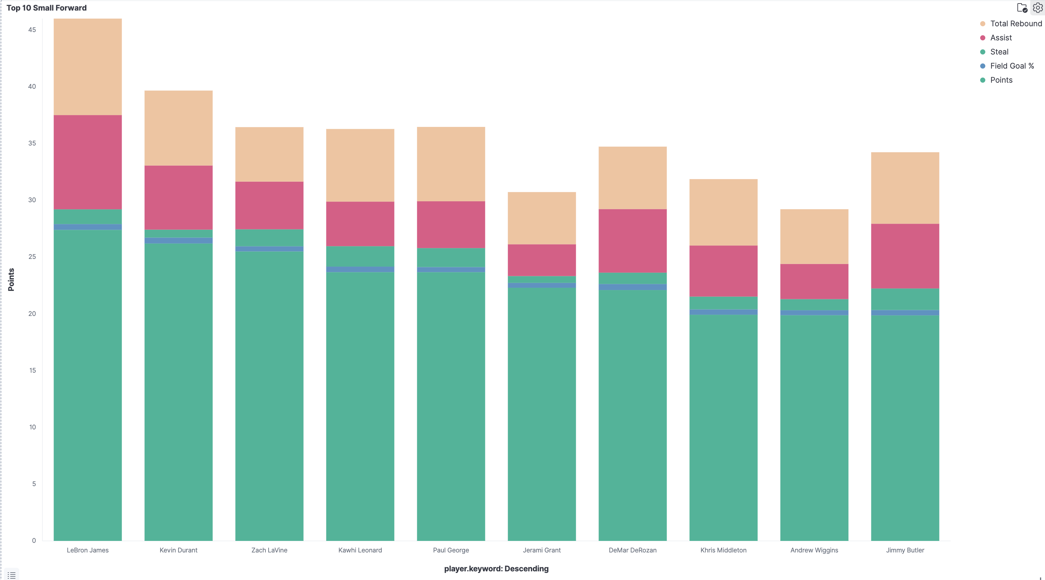
Notes:
- LeBron James stands out as the Small Forward with the greatest overall contribution, excelling in points, assists, steals, and total rebounds. This confirms his role as a versatile player dominant in many areas.
- Kevin Durant also performs strongly with high total points, good field goal percentage, and notable contributions in assists and rebounds, indicating solid offensive performance.
- Other players like Zach LaVine, Kawhi Leonard, and Paul George show balance between points, assists, and rebounds, with steals being smaller but still present.
- Assist numbers are notably significant for players like LeBron James and DeMar DeRozan, highlighting their roles in passing and organizing the team's offense.
- Steals form a smaller part compared to other stats but remain a key defensive indicator, with players like Jimmy Butler and DeMar DeRozan standing out defensively.
Field Goal % reflects consistent shooting efficiency among top Small Forwards, especially Kawhi Leonard and Paul George.

Slide 26
CONCLUSION 1/2
LeBron James (Small Forward):
Highest overall contribution: points, assists, steals, rebounds
Very versatile and dominant player
Kevin Durant:
Strong scorer with good shooting accuracy
Good at assists and rebounds
Zach LaVine, Kawhi Leonard, Paul George:
Balanced in points, assists, rebounds
Some steals, but fewer
Notes:
LeBron James stands out as the Small Forward with the largest overall contribution, excelling in points, assists, steals, and total rebounds. This confirms his role as a versatile player dominant in many aspects.
Kevin Durant also performs strongly with high total points, good field goal percentage, and significant contributions in assists and rebounds, indicating strong offensive performance.
Other players like Zach LaVine, Kawhi Leonard, and Paul George show a balance between points, assists, and rebounds, with steals being relatively small but still present.
The assist category is quite prominent for players like LeBron James and DeMar DeRozan, showing their role in distributing the ball and organizing the team's offense.
Steals account for a smaller portion compared to other categories but remain an indicator of defensive skill, with players like Jimmy Butler and DeMar DeRozan standing out relatively more.
Field Goal % reflects consistent shooting efficiency among top Small Forwards, especially players like Kawhi Leonard and Paul George.

Slide 27
CONCLUSION 2/2
Assists:
Important for LeBron James, DeMar DeRozan (team playmakers)
Steals:
Smaller stats but show defensive ability
Jimmy Butler, DeMar DeRozan stand out
Field Goal %:
Shows efficient shooting
Kawhi Leonard and Paul George are consistent
Notes:
LeBron James stands out as the Small Forward with the largest overall contribution, excelling in points, assists, steals, and total rebounds. This confirms his role as a versatile player dominant in many aspects.
Kevin Durant also performs strongly with high total points, good field goal percentage, and significant contributions in assists and rebounds, indicating strong offensive performance.
Other players like Zach LaVine, Kawhi Leonard, and Paul George show a balance between points, assists, and rebounds, with steals being relatively small but still present.
The assist category is quite prominent for players like LeBron James and DeMar DeRozan, showing their role in distributing the ball and organizing the team's offense.
Steals account for a smaller portion compared to other categories but remain an indicator of defensive skill, with players like Jimmy Butler and DeMar DeRozan standing out relatively more.
Field Goal % reflects consistent shooting efficiency among top Small Forwards, especially players like Kawhi Leonard and Paul George.

Slide 28
RECOMENDATION

Slide 29
TRADING TARGET
PG
PF
C
SF
SG

Slide 30
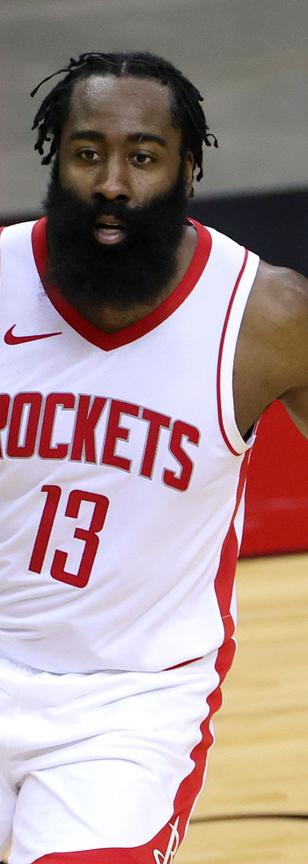
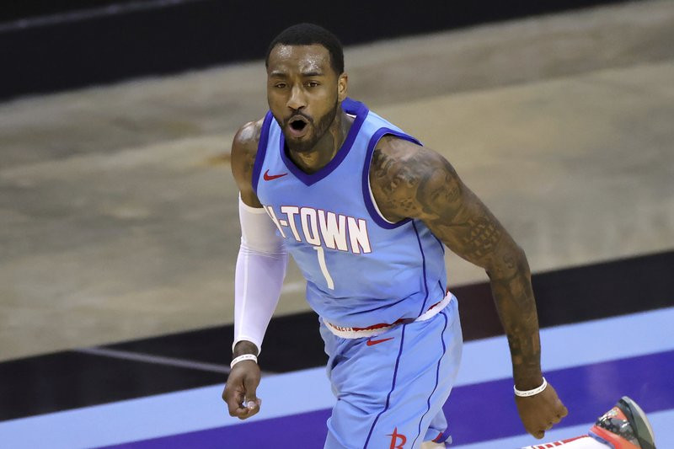
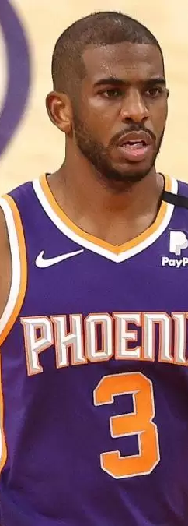
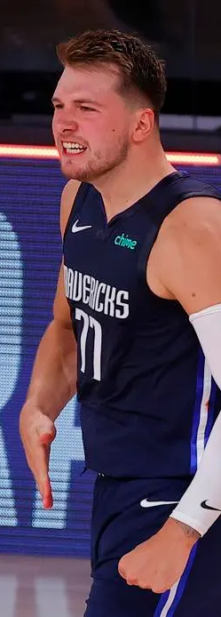
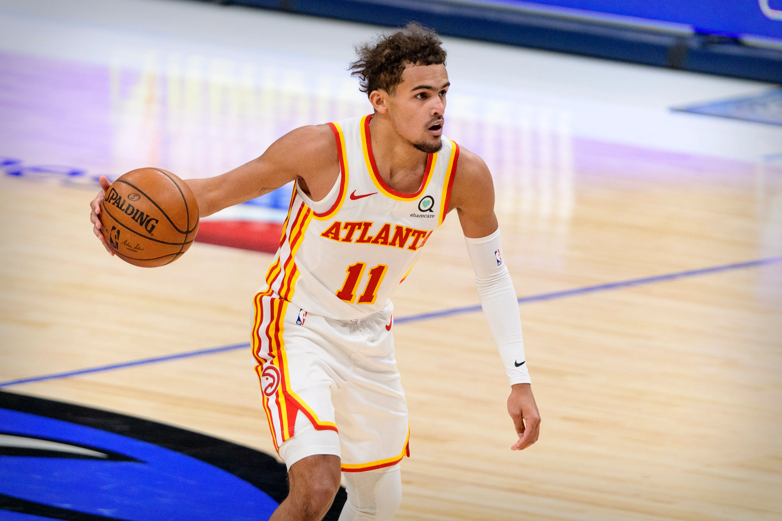
POINT GUARD
Notes:
James Harden: High assists and points, but turnovers need to be controlled
John Wall: High steals, with lower turnovers compared to Harden and Westbrook
Chris Paul: High steals, very experienced so likely more stable
Luka Doncic: Big contributor in assists and points but has relatively high turnovers
Trae Young: Aggressive playmaker with high assists and significant points

Slide 31
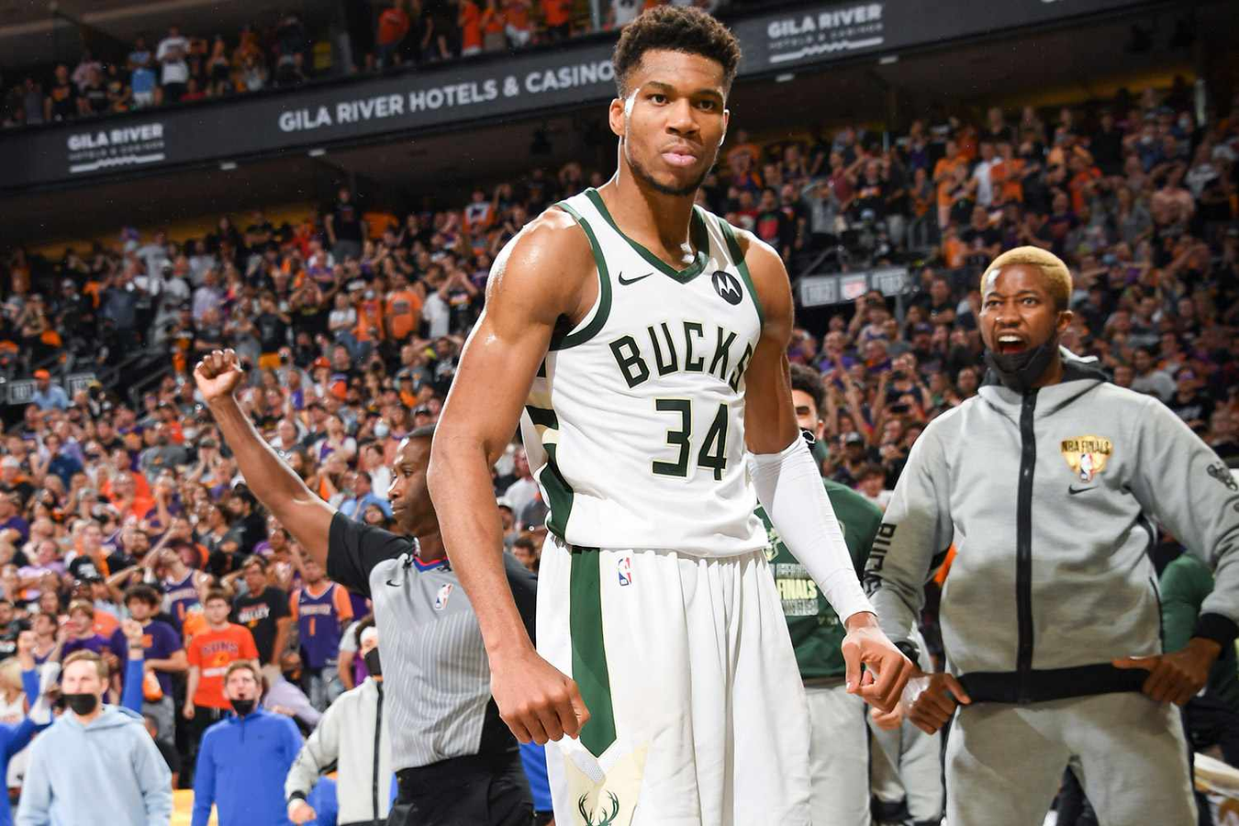
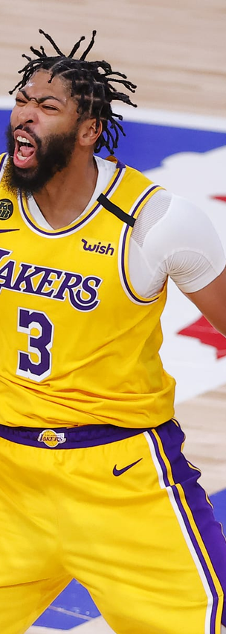
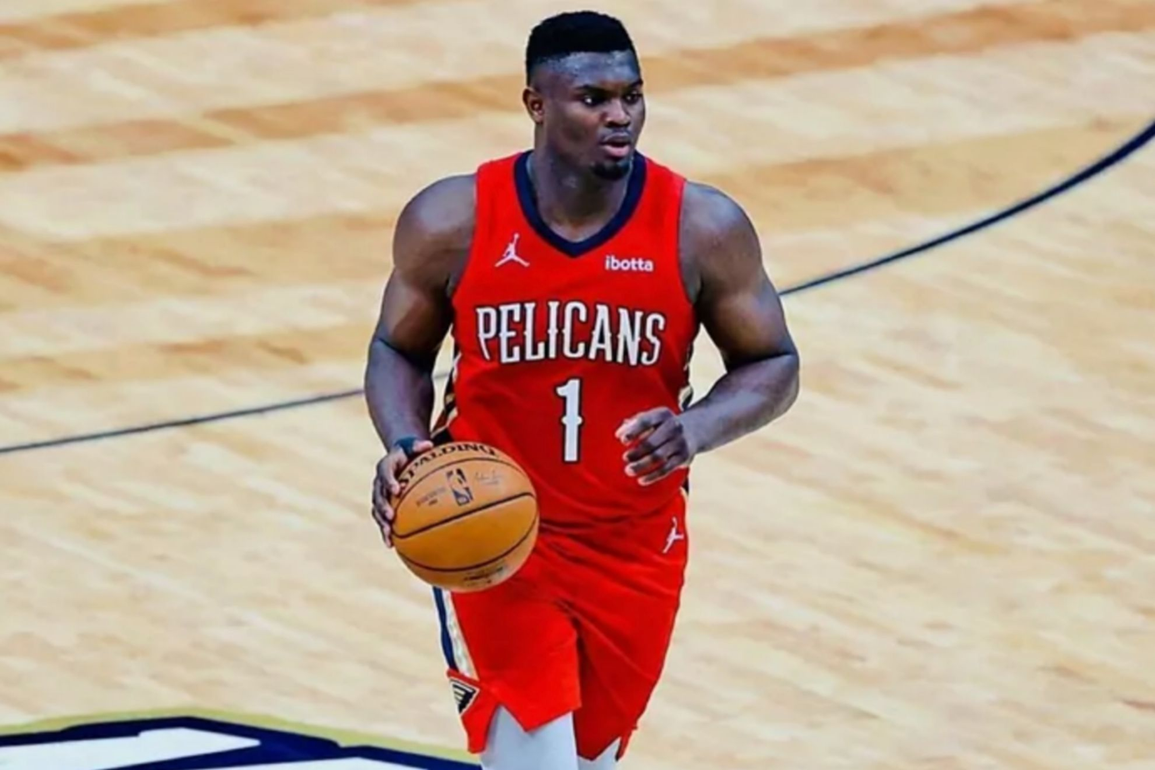
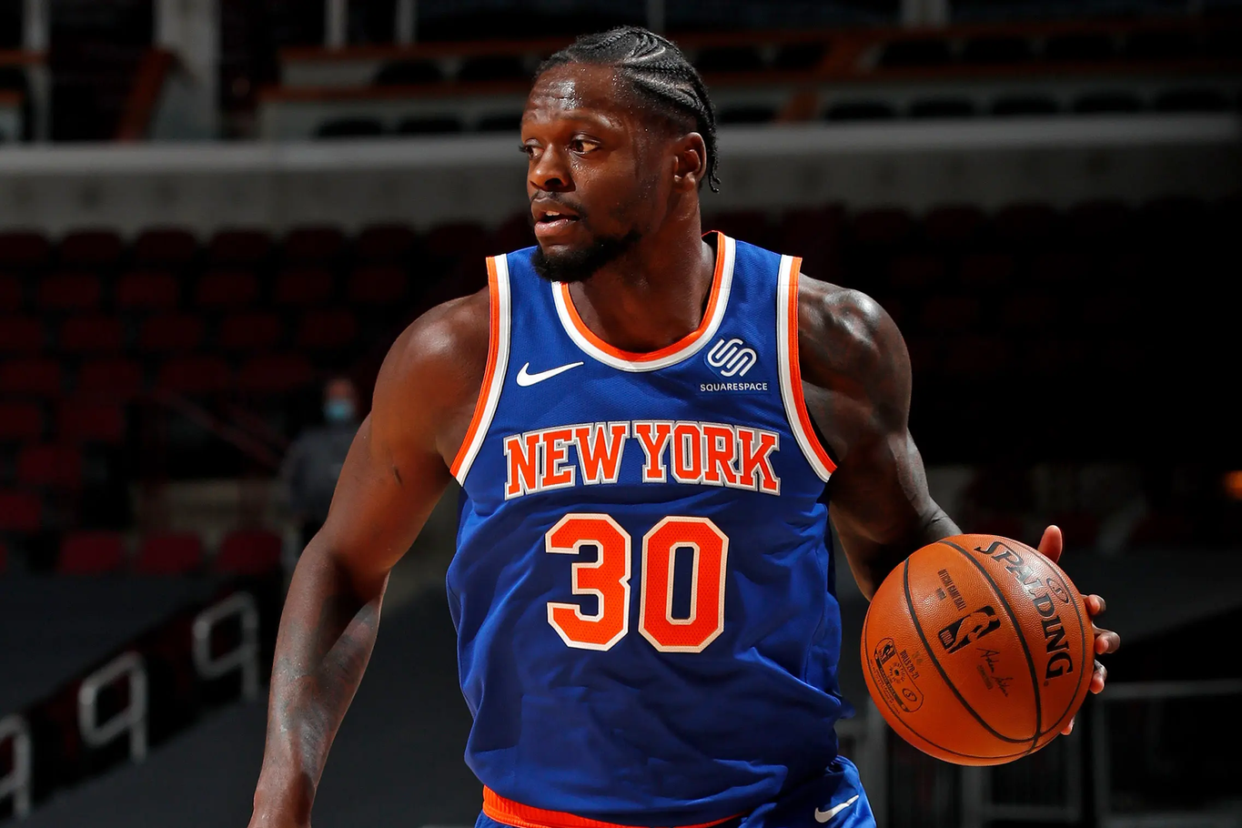
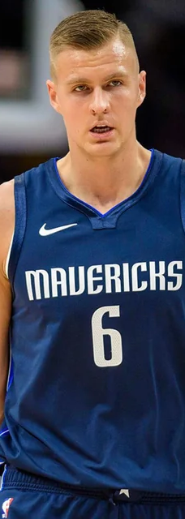
POWER FORWARD
Notes:
Giannis Antetokounmpo: Best contributions in points, rebounds, and blocks at this position
Anthony Davis: High points and rebounds, block numbers are lower
Zion Williamson: Significant points and strong rebounds
Julius Randle: Competitive points and rebounds for Power Forward
Kristaps Porzingis: Versatile player with balanced stats in points, rebounds, and blocks

Slide 32
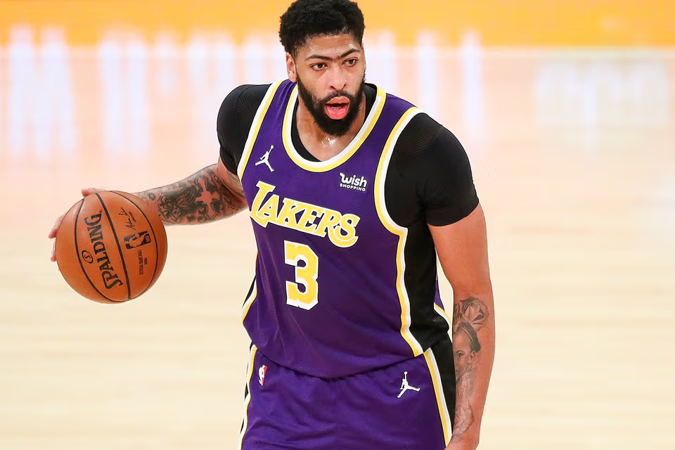
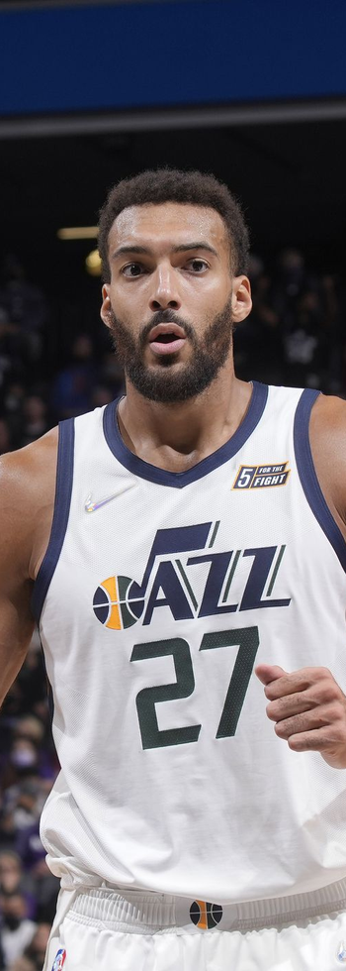
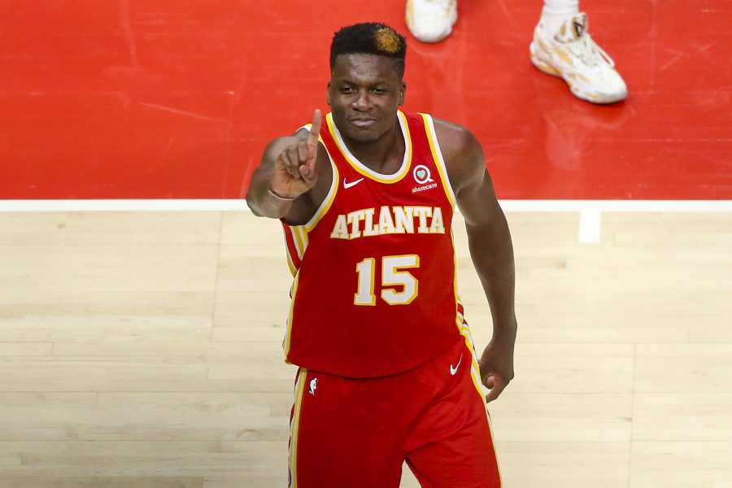
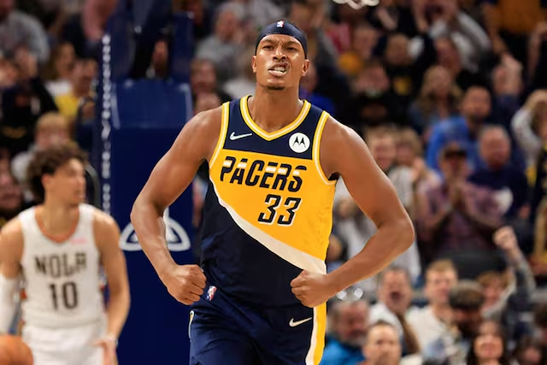
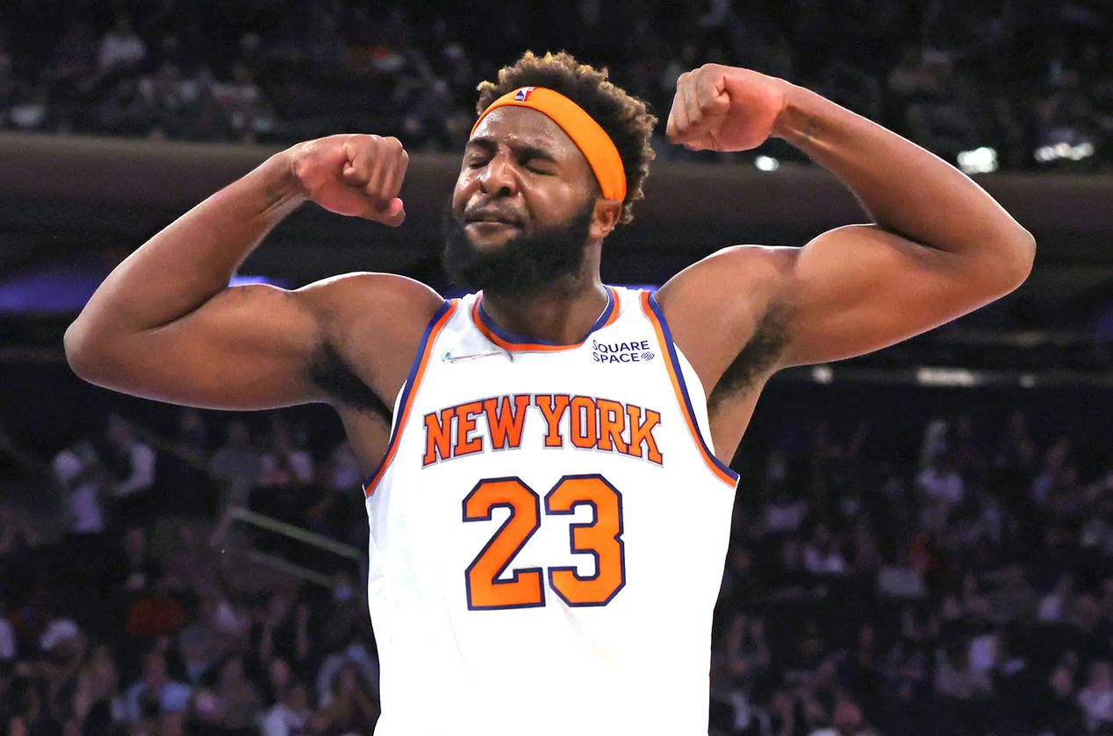
CENTER
Notes:
Anthony Davis: Productive center with high points and rebounds
Rudy Gobert: Defensive dominant with high rebounds and blocks
Clint Capela: Very good rebounds and blocks in the paint area
Myles Turner: Consistent blocks and rebounds, solid defensive center
Mitchell Robinson: Efficient in blocks and rebounds, though lower points

Slide 33
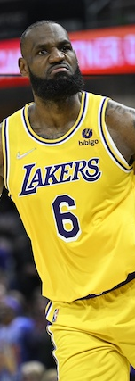
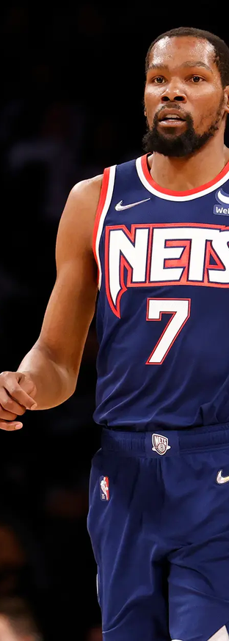
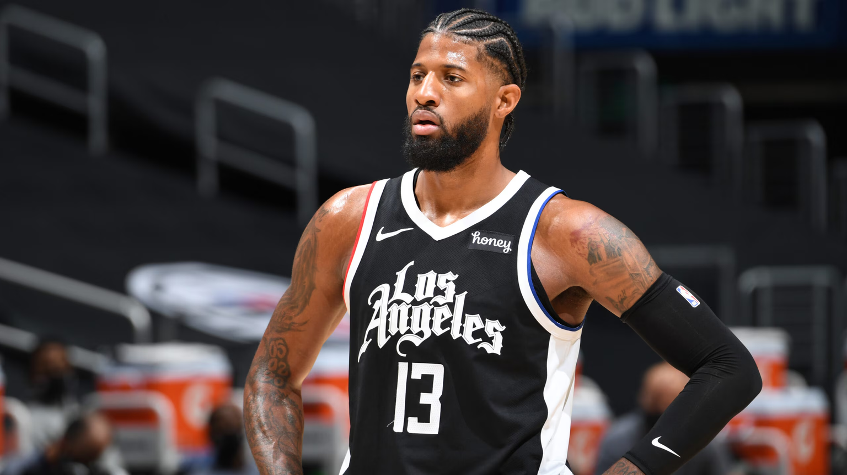
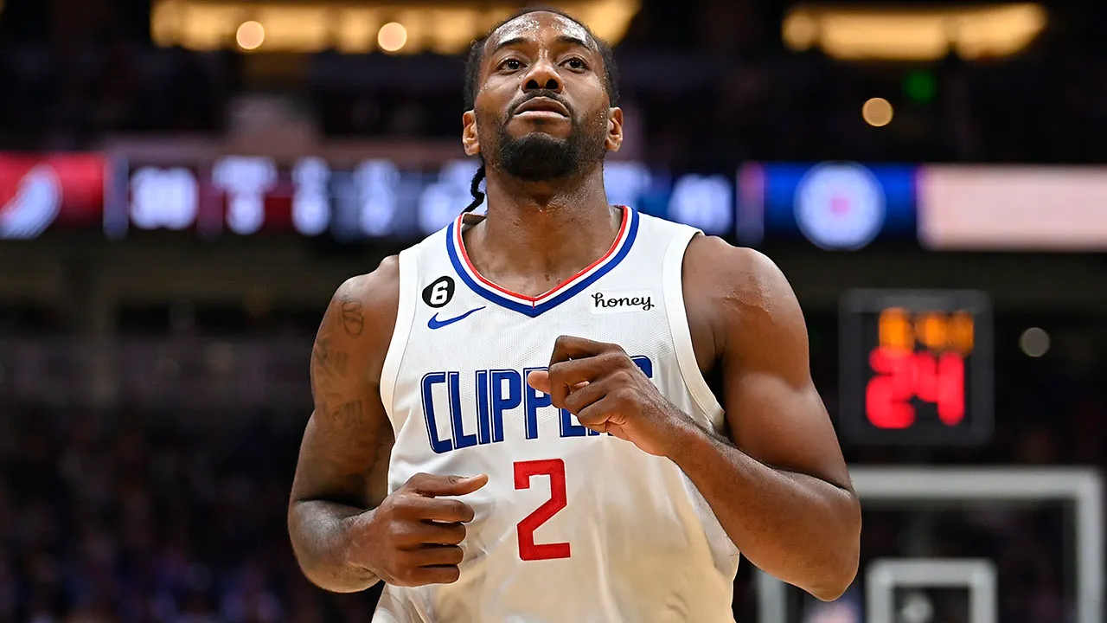
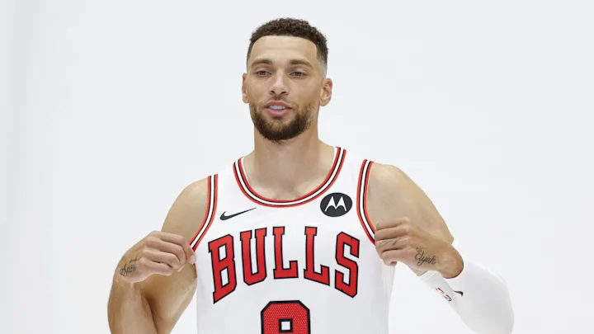
SMALL FORWARD
Notes:
LeBron James: Versatile player with balanced points, assists, steals, and rebounds
Kevin Durant: Scorer contributing with rebounds and assists
Paul George: Balanced offense and defense with points and steals
Kawhi Leonard: High shooting efficiency and strong on defense
Zach LaVine: High scorer with efficient field goals

Slide 34
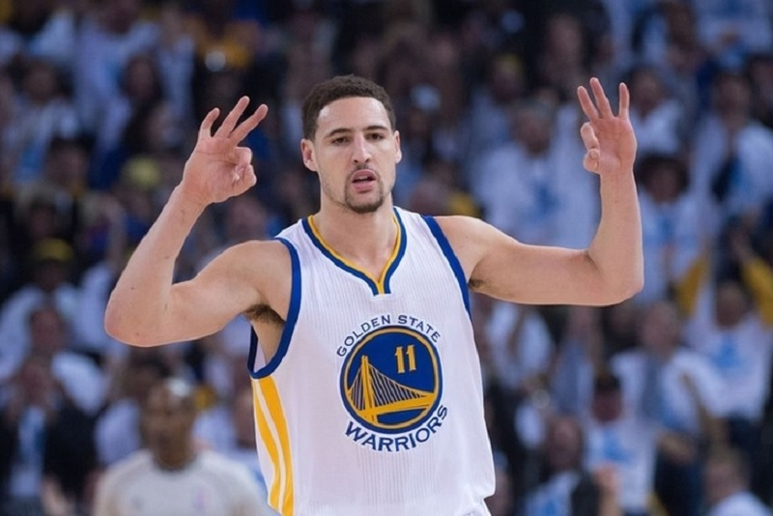
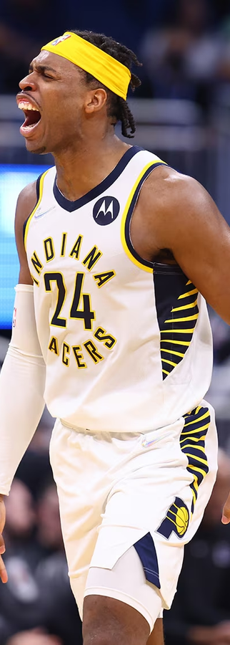
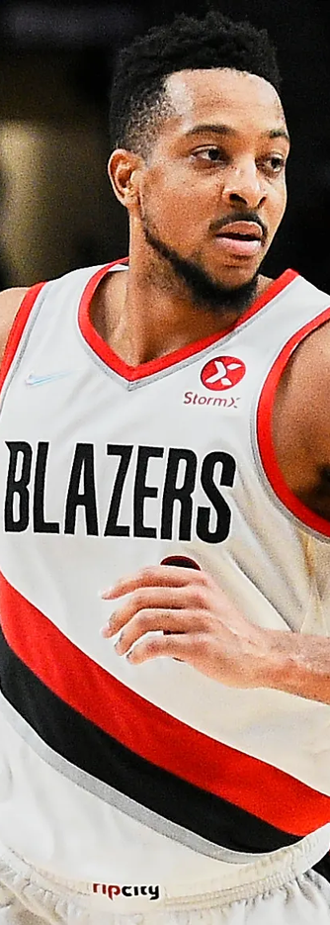
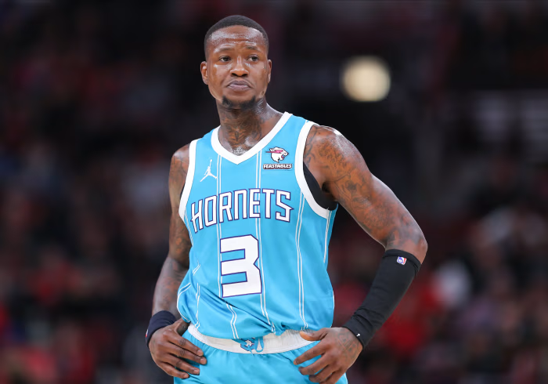
SHOOTING GUARD
Notes:
James Harden: Strong scorer and 3-point shooter, can also be a main playmaker
Klay Thompson: Very effective and consistent 3-point shooter
Buddy Hield: High volume 3-point shooter
CJ McCollum: Consistent scorer, plays a scoring role
Terry Rozier: Shooting guard with high points and steals

Slide 35
IMPORTANT NOTE
Other teams may not agree to all trades due to contracts, salary cap, and team needs.
Prioritize players with reasonable contracts to avoid salary cap limits.
Consider rookie players and draft picks as cost-effective long-term investments.
Use trades to fill important or weak positions in the team.
Choose players with good performance and low injury risk for stability.
Notes:
Not all trades will be accepted by the other team because of player contracts, salary caps, and different team needs.
It is better to choose players with reasonable contracts to avoid salary cap problems and keep options open for future strategies.
Do not ignore rookie players and draft picks. Investing in the NBA Draft can be a long-term solution with lower costs and big potential.
Make trades to fill the most important or weakest positions in the team to improve performance effectively.
Choose players who play well and have a low injury risk for team stability.

Slide 36
THANK
YOU

